Slide 1

Diffusion Convolutional Recurrent Neural Network: Data-Driven Traffic Forecasting
(Yaguang Li et al., ICRL 2018)
Presented by: LE VAN DUC (2019-38262)

Slide 2
Outline
Introduction
Graph Diffusion Convolution Definition
Diffusion Convolutional Recurrent Neural Network (DCRNN)
Detailed Implementation Explanation
Training & Testing
Real Experiments Running
More Evaluations w/ SOTA methods
Conclusions

Slide 3

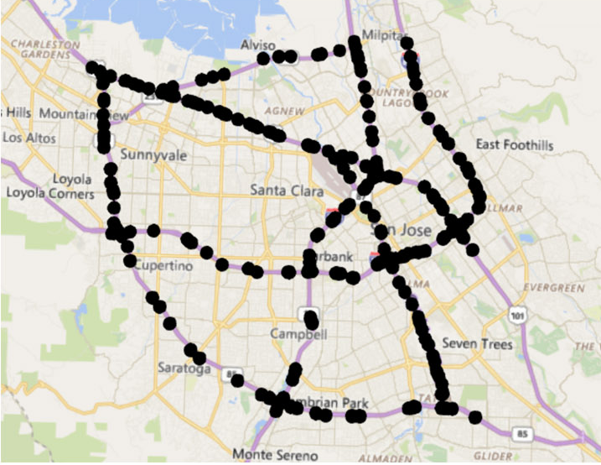
Introduction
The paper tries to solve traffic forecasting problems by:
A Diffusion Process on a Directed Graph to model the Spatial Correlations in Traffic Flow => Diffusion Convolution
An Encoder-Decoder architecture to capture the Temporal Dependency => Diffusion Convolutional Gated Recurrent Unit (DCGRU)
Traffic Sensor Network

Slide 4
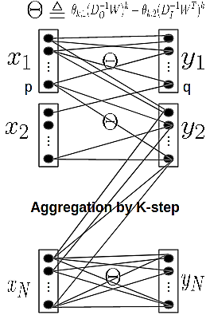
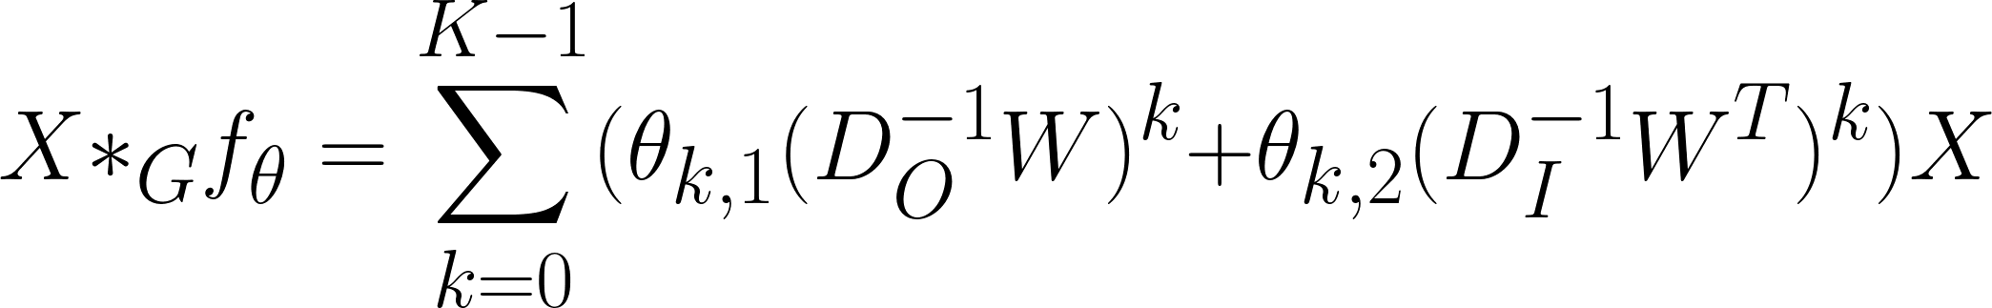
Problem Statement & Diffusion Convolution Definition
Traffic Forecasting Problem:
Sensor networks as a weighted directed graph
V = {traffic sensors}, E = {roads between sensors},
Wij = road network distance
Diffusion Convolution:
Model the spatial correlations of traffic flow as a Diffusion process by a Random Walk on G with a state transition matrix
is the out-degree diagonal matrix.
Define the diffusion convolution over a graph signal X and a filter f as:
ϴ are the learnable parameters, 2 transition matrices represent the bidirectional diffusion process. K is the diffusion steps of the random walk.
Diffusion convolution

Slide 5



Diffusion Convolutional Layer
Diffusion Convolutional (DiffConv) Layer:
Build a diffusion convolutional layer that maps P-input features to Q-output features.
X is input, H is output, {f_{θ}} are filters, a is the activation function (e.g. ReLU, Sigmoid).
This layer can be trained by a stochastic gradient based method.
Relation with Spectral Graph Convolution:
Spectral Graph Convolution (e.g. ChebNet) can be considered a special case of DiffConv.
This paper proved that, the spectral graph convolution defined as
With L= ΦΛΦ^{T} & F(θ)= (polynomial filter) is equivalent to graph DiffConv up to a similarity transformation, when G is undirected graph.

Slide 6
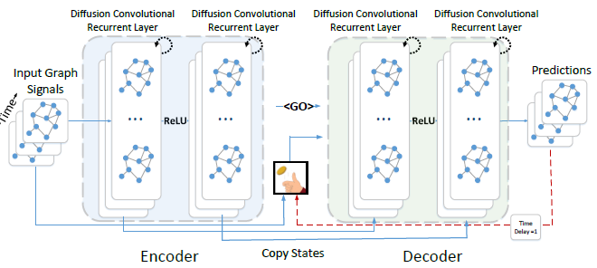
Diffusion Convolutional Recurrent Neural Network (DCRNN)
Use Recurrent Neural Networks (e.g Gated Recurrent Unit, GRU) to model the temporal dependency.
Replace the matrix multiplications in a GRU cell with DiffConv => DiffConv GRU cells.
For multiple times ahead traffic flow prediction, employ an Encoder-Decoder model with both networks are DiffConv Recurrent layers => DCRNN model.

Slide 7
Code Link & Experiments Results
Code Link: https://github.com/vanduc103/gcn2020_project
You can check README file in the Code Link to see my Training files that show the Experiments Results.
The instructions to prepare the data, construct the Graph, training, and testing are in the README file in the Code Link.
Model training:
python dcrnn_train.py --config_filename=data/model/dcrnn_la.yaml
Model testing (with 1 pre-trained model):
python run_demo.py --config_filename=data/model/dcrnn_DR_1_h_12_64-64_lr_0.01_bs_64_0527211535/config_100.yaml

Slide 8
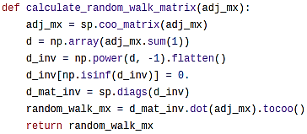


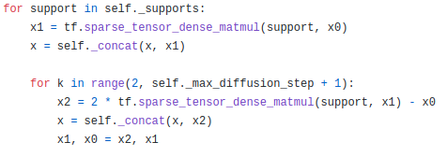
Detailed Implementation Explanation
represent adjacency matrix in sparse form
Diffusion Filter (file lib/utils.py)
Random Walk filter (D_{O}⁻¹W): see code on the right
Bi-directional RW filter (D_{I}⁻¹W & D_{O}⁻¹W):
compute RW filter 2 times with adj_mx & adj_mx transpose.
Scaled Laplacian filter: compute Spectral Graph Conv (to compare w/ DiffConv)
Identity filter: ignore spatial filter by multiplying w/ identity matrices.
DiffConv GRU Cell (file model/dcrnn_cell.py)
GRU Gates computation by DiffConv:
Reset Gate (r), Update Gate (u)
Candidate (C) and Output (H)
Input, Output:
Input: Batch of Historical Traffic Time series
Input Shape: (B, num_nodes * input_dim)
Output: Batch of Predicted Values
Output Shape: (B, output_size)
compute out-degree diagonal matrix (D_{O}⁻¹)
D_{O}⁻¹W as sparse-dense matrix multiplication
Code for DiffConv: Recursive Sparse-Dense Matrix Multiplication with Max-Diffusion-Step (1,2,3…) => O(KN)

Slide 9

Diffusion Convolutional Recurrent Neural Network Model (DCRNN Model)
DCRNN Model (file model/dcrnn_model.py)
Build DiffConv GRU Cell and stack many cells to build Encoder and Decoder layers:
Some important parameters:
max_diffusion_steps: defines number of diffusion steps (K-hop) we would run by random walk from a node. Default is 2 diffusion steps.
filter_type: defines which Diffusion Filter we will use. Default is “dual_random_walk” that applies bi-directional RW filter. There are 3 other filters: “random_walk”, “scaled laplacian” (for Spectral GNN computation), “identity” (for not applying spatial learning in DCRNN model)
horizon: number of time intervals will be forecasting (each time interval is 5 minutes). Default is 12 horizons that means forecasting from 5 minutes to 1 hour.

Slide 10
Training and Testing
Data Preparation: collect traffic sensors data and generate training set
Traffic sensors data: collect traffic sensors data from Los Angeles (METR-LA) and the Bay Area (PEMS-BAY). Each sensor has time interval 5 minutes.
Generate training data: generate train/val/test data by aggregating some time windows (here is 12 time windows of each 5 minutes = total 1 hour prediction)
Graph Construction:
Generate Adjacency Matrix as Weighted Distance Matrix between pairwise road sensors. Choose threshold K (=0.1) to make graph sparse.
Model Training
Training configuration: in file .yaml, including model and training hyperparameters.
Loss function: Use MAE (Mean Absolute Error) Loss
Training monitoring: in file info.log
Model Evaluation
Baseline methods evaluation: HA (Historical Average), VAR (Vector Auto-Regressive), Static Prediction (fixed prediction)
Metric: there are 3 evaluation metrics: MAE metric, MAPE (Mean Absolute Percentage Error) metric, RMSE (Root Mean Squared Error) metric.

Slide 11
Running Experiments
Dataset | T | Metric | Static | HA | VAR | DCRNN
METR-LA | 15’ | MAE RMSE MAPE | 4.02 8.69 9.39% | 4.15 7.77 12.90% | 4.37 7.78 10.08% | 2.67 5.19 6.88%
 | 30’ | MAE RMSE MAPE | 5.09 11.13 12.21% | 4.15 7.77 12.90% | 5.40 9.37 12.75% | 3.08 6.33 8.41%
 | 1h | MAE RMSE MAPE | 6.79 14.21 16.71% | 4.15 7.77 12.90% | 6.50 10.68 15.84% | 3.58 7.56 10.33%
Recover “comparison performance” of DCRNN model (with forecasting time T = 15’, 30’, 1h) as in the paper: use dual_random_walk filter, max_diffusion_step = 2, horizon = 12.
Experiment to investigate the effect of diffusion convolution (spatial dependence modeling): NoDiffConv (use Identity filter), UniDiffCov (use RW filter), FullDiffConv (use Bi-directional RW filter)
Dataset | T | Metric | NoDiffConv | UniDiffConv | FullDiffConv
METR-LA | 15’ | MAE RMSE MAPE | 2.98 5.90 7.90% | 2.72 5.25 7.06% | 2.67 5.19 6.88%
 | 30’ | MAE RMSE MAPE | 3.58 7.29 10.22% | 3.14 6.39 8.67% | 3.08 6.33 8.41%
 | 1h | MAE RMSE MAPE | 4.45 8.99 13.77% | 3.64 7.62 10.72% | 3.58 7.56 10.33%

Slide 12
Dataset | T | Metric | Undirected (Laplacian) | Directed (Laplacian) | Directed (DiffConv)
METR-LA | 15’ | MAE RMSE MAPE | 2.72 5.25 7.06% | 2.68 5.22 6.91% | 2.67 5.19 6.88%
 | 30’ | MAE RMSE MAPE | 3.14 6.39 8.67% | 3.08 6.34 8.46% | 3.08 6.33 8.41%
 | 1h | MAE RMSE MAPE | 3.64 7.62 10.72% | 3.57 7.56 10.40% | 3.58 7.56 10.33%
Experiment to study the effect of graph construction: Undirected (use Laplacian filter or Spectral GNN) vs. Directed Graph (use Laplacian filter or DiffConv with Bi-directional RW filter)
Experiment to examine the effect of Diffusion Steps (K-hop): vary max_diffusion_step from 1 to 5.
Dataset | T | Metric | K = 1 | K = 2 | K = 3 | K = 4 | K = 5
METR-LA | 15’ | MAE RMSE MAPE | 2.68 5.16 6.87% | 2.67 5.19 6.88% | 2.69 5.23 6.92% | 2.74 5.33 7.04% | 2.97 5.74 8.19%
 | 30’ | MAE RMSE MAPE | 3.09 6.27 8.48% | 3.08 6.33 8.41% | 3.09 6.35 8.44% | 3.15 6.47 8.59% | 3.50 7.24 10.70%
 | 1h | MAE RMSE MAPE | 3.58 7.49 10.50% | 3.58 7.56 10.33% | 3.58 7.58 10.34% | 3.63 7.70 10.50% | 4.22 9.06 14.07%

Slide 13
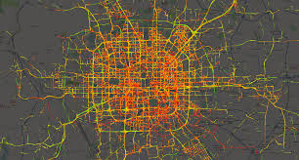
More Evaluations
Compare with 2 recent SOTA methods
Yu et al., Spatio-Temporal Graph Convolutional Networks: A Deep Learning Framework for Traffic Forecasting, IJCAI 2018
Use common Spectral filter (e.g in ChebNet) and generalize to multi-dimensional tensors.
Do not use RNN because of time-consuming recurrent computation. Use only Conv Block with the combination of Graph Spatial Conv and Gated Temporal Conv.
Diao et al., Dynamic Spatial-Temporal Graph Convolutional Neural Networks for Traffic Forecasting, AAAI 2019
Learn the Laplacian Matrix for traffic networks by specific time-of-day dynamically (not assume adjacency matrix unchanged as previous) => Dynamic Laplacian Matrix Estimator.
Other layers similar to previous methods (a ConvBlock = Graph Conv + Gated Temporal Conv)
Apply with other spatiotemporal datasets (crowd flows)
Dataset description: Taxi Trajectory Dataset in Beijing (2014). Data = Inflow + Outflow at a Region at a Time.
Data preparation (in folder data/beijing2014):
Generate training data by time windows 30 minutes.
Compute Adjacency Matrix as Weighted Distance Matrix of pairwise region distance.
Training & Testing with taxi trajectory data (future plan)

Slide 14
Conclusions
This is one of the first papers that proposes to apply Graph Diffusion Convolutional Networks into a spatiotemporal problem like Traffic Forecasting.
The leverage of Diffusion Convolution has given good forecasting results.
Recent SOTA methods have pointed out and solved some weak points of this models, e.g. a time-consuming recurrent network computation or an impractical static adjacency matrix for dynamic problems like traffic.
GNN has promising power in solving real-life problems. I hope that we can successfully apply GNN in many real-world problems in the future.

Slide 15
Thank you for reading! HAVE A GOOD DAY!

